Slide 1
Security of Hypervisors in Cloud Computing
Kolla Ranga Dinakar
B.Tech. (CSE) 5Th Semester
16341A0597
Under the Guidance of
P.Someswari
Asst.Prof.
Dept. of CSE, GMRIT

Slide 2
Abstract
Virtualization in Cloud computing is making a virtual image of the storage devices or servers or network resources, so that they can be used in multiple machines at the same time.
A virtual machine is the software implementation of any computing device, machine or computer that executes the series of instructions or programs as an actual machine.
Security of hypervisor in cloud computing solves the attacks that allow a malicious virtual machine (VM) to compromise the Hypervisor.

Slide 3
Introduction
Virtualization is used to run multiple virtual machines (VM) on a single hardware platform.It reduces the cost for customer.
There should be multiple VM tenants who do not trust each other to share the same physical hardware where the data may be theft.
The hypervisor is the piece of software that manages resources and isolates the VMs from each other. If a malicious VM is able to break free from the isolation that the hypervisor is supposed to guarantee, or compromise the hypervisor itself, then all the other VMs on the same physical machine are vulnerable it may steal data and can slow down the other VMs.

Slide 4
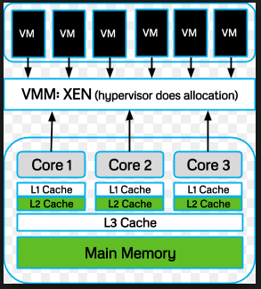
Once co-resident, the malicious VM can attempt to compromise the hypervisor, or steal data using a side-channel.

Slide 5
LITERATURE SURVEY
[1]Andrew R.Riddle;Soon M Chung “A Survey on the Security of Hypervisors in Cloud Computing”
This include attacks that allow a malicious virtual machine (VM).
Techniques used by malicious VMs to steal more than their allocated share of physical resources (Xen,side-channel,co-residency)
Security requirements and architectures for hypervisors to successfully defend against such attacks
[2]S. Yu, X. Gui, J. Lin, X. Zhang, and J. Wang, “Detecting VMs Co-residency in the Cloud: Using Cache-based Side Channel Attacks,” Elektronika Ir Elektrotechnika, 19(5), 2013, pp. 73– 78.
In this the VMs Co-residency Detection Scheme via cache-based side channel attacks (VCDS) to get the location of the specified VM. Using load pre-processor based on cubic spline interpolation.

Slide 6
VCDS computes the co-residency probability to describe VMs co-residency quantitatively. The experimental results show that VCDS improves the true detection rate.
[3]B. Ding, Y. He, Y. Wu, and J. Yu, “Systemic Threats to Hypervisor Non-control Data,” Information Security, 7(4), 2013, pp. 349–354.
To secure hypervisors mainly focus on code or control-data integrity, without paying attention to non-control data integrity.
Several types of non-control data within the Xen hypervisor
† Privilege related data
† Resource utilisation related data
† Security policy related data
[4] J. Szefer, E. Keller, R. Lee, and J. Rexford, “Eliminating the Hypervisor Attack Surface for a More Secure Cloud,” Proc. of 18th ACM Conference on Computer and Communications Security, 2011, pp. 401–412.

Slide 7
We eliminate the hypervisor attack surface by enabling the guest VMs to run natively on the underlying hardware while maintaining the ability to run multiple VMs concurrently.
(i) pre-allocation of processor cores and memory resources
(ii) use of virtualized I/O devices
[5] P. Karger, “Multi-level Security Requirements for Hypervisors,” Proc. of 21st Annual Computer Security Applications Conference (ACSAC 2005), 2005, pp. 267–275.
This paper will describe are the requirements and implications of a multi-level secure mode of operation as was defined many years ago in DoD Directive 5200.28 and in the implementing manual.

Slide 8
Methodology
In this mainly there are
(i) virtual machines Co-residency attacks : using side- channel mechanism.
(ii) Prime-trigger-probe method.
(i)CACHE-BASED SIDE CHANNEL ATTACKS :VMCD’S
Before detailing, we divide VMs into three roles in the attack scenario. They are malicious VM, victim VM and noisy VM, respectively. Malicious VM belongs to the attacker, which probes and analyzes cache activities. Victim VM is the attack target. Noisy VM resides in the same host with the malicious VM, which interferes with the attack.
Commonly, cache-based side channel attacks consist of two major steps:
(1) measuring the cache load and
(2) analyzing the cache load to extract the private information.

Slide 9
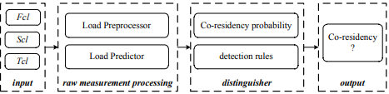
Here,It consists three cache load measurements sets
1.The first set is obtained before accessing the services of victim VM, marked as First cache load set, short for Fcl=(fcl1,fcl2,…, fcln)
2. The second set is probed when victim VM is doing the computation produced by accessing the service, marked as Second cache load set, short for Scl=(scl1, scl2,…,scln)
3. The third set is probed after the end of the service computation, marked as Third cache load set, short for Tcl=(tcl1, tcl2, …, tcln).
VCDS consists of two major modules which are raw measurement processing and distinguisher.

Slide 10
Step 1: Load preprocessor takes as its inputs Fcl, Scl and Tcl, and returns Fcl1 , Scl1 and Tcl1 which respectively represent the load trend of Fcl, Scl and Tcl.
Step 2: Load predictor takes as its inputs Fcl1 and Scl1 respectively, and returns Fcl2 and 2 1 Scl , which are the estimated caches load in the near future for Fcl1 and Scl1 . Meanwhile, choosing specified elements from Scl1 and Tcl1 to construct 2 2 Scl and Tcl2
Step 3:Obtain 3 Fcl , 3 1 Scl , 3 2 Scl and 3 Tcl according to 2 Fcl , 2 1 Scl , 2 2 Scl and 2 Tcl , based on the normal cloud model [8]. Fcl3 includes twofold information of the load value and its membership degree. And the same to 3 1 Scl , 3 2 Scl and Tcl3 .
Step 4: Distinguisher takes as its inputs Fcl3 , 3 1 Scl , 3 2 Scl and Tcl3 , and returns the result based on the co-residency probability computing algorithm and the detection rules

Slide 11
Prime-trigger-probe method
Main steps involved in this are:
(1)Prime: Malicious VM allocates a contiguous buffer of b bytes and fills the entire cache by reading the buffer at s-byte offsets. Here, b should be larger than cache size; s is the cache line size;
(2) Wait: Malicious VM waits for a pre-specified time interval. In this interval, cache is used by other co-resident VMs, hopefully in favor of the victim VM;
(3) Probe: Malicious VM reads the buffer at s-bytes offsets again and measures the time.

Slide 12
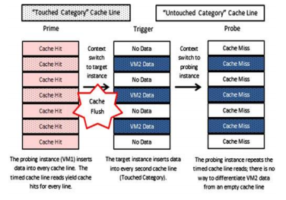
Cache-Flush:
Our code uses the selective cache flushing method between the prime and trigger (considered as the cache) so that the probing instance will not be able to see the cache hit data. The main code comprises of two parts: 1) Allocating the process to the cache memory and 2) Flushing the cache memory based on the domain the process switches and reporting the same to the probing instance.

Slide 13
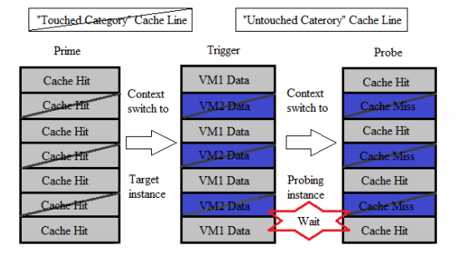
Cache-Wait:
Cache-Wait function waits the cache execution for the specific time. Cache-Wait operates only in one condition. When the context switch happens and the current domain requires data, both from the cache memory (cache hit) and the main memory (cache miss). And if the total time required for accessing the main memory is higher than the cache memory. Only at this particular instant, the Cache-Wait function operates That is, when context switch happens and the current VM performs cache hit and cache miss. And if the time taken for the cache miss is greater than the cache hit, at this instant Cache-Wait operates.

Slide 14
Conclusion
Virtualization is a key enabling technology of the cloud, allowing many guest machines to share the same physical hardware. The hypervisor is supposed to be secure from attacks and effectively isolate the VMs, yet potential security flaws are evident. VM escape is the most serious of all the attacks discussed because the escaped VM would be free to compromise all the other co-resident VMs. Solving the VM escape problem in the architecture and design of hypervisors. Other attacks that focus on stealing data via side-channels and prime-trigger-probe method can be mitigated by adding noise to the side-channel. Solving the problem of hypervisor security is an important step in providing a secure cloud environment for businesses and consumers to utilize.

Slide 15
References
1. Andrew R.Riddle, A Survey on the Security of Hypervisors in Cloud Computing,https://ieeexplore.ieee.org/document/7165091/
2. T.Swathi et al, International Journal of Computer Science and Mobile Computing,virtualization in cloud computing, Vol.3 Issue.5, May- 2014, pg. 540-546. Available online at http://www.ijcsmc.com/ .
3. nancy jain,sakshi chowdary “overview of virtualization in cloud computing” Poonam V. Kapse,
R. C. Dharmik, "An effective approach of creation of virtual machine in cloud computing", I-SMAC (IoT in Social Mobile Analytics and Cloud) (I-SMAC) 2017.

Slide 16
4. Malhotra L, Department of Computer Science and Engineering, Agarwal D, Jaiswal A (2014) Virtualization in Cloud Computing. J Inform Tech Softw Eng 4:136, journal of information technology and software engineering open access https://www.omicsonline.org/peer-reviewed/virtualization-in-cloud-computing
5. S. Yu, X. Gui, J. Lin, X. Zhang, and J. Wang, “Detecting VMs Co-residency in the Cloud: Using Cache-based Side Channel Attacks,” Elektronika Ir Elektrotechnika, 19(5), 2013, pp. 73– 78.
6. Hypervisor https://en.wikipedia.org/wiki/Hypervisor

Slide 17
THANK YOU

